Slide 1


Bond Total Return Swaps
Theory, Pricing & Practice
Nicholas Burgess

Slide 2

PART ONE: Theory
Bond Total Return Swaps
Introduction to Bond TRS
Why Trade a TRS?
Contract Specifications
Constant Units vs Constant Notional
PART TWO: Pricing & Practice
Case Studies
Pricing Formulae
Bond TRS Case Study
Quant Research Papers
https://ssrn.com/author=1728976
Book: Low Latency Interest Rate Markets
https://github.com/nburgessx/SwapsBook

Slide 3
PART ONE - THEORY
Bond Total Return Swaps

Slide 4

Bond TRS – Introduction to Bond TRS
What is a Bond TRS?
The funded purchase of a Bond, where we receive the coupons and performance cash flows
The ‘payer’ passes all coupons and changes in Bond price are passed to the ‘receiver’
Cash Flows
The payer holds the underlying bond, but passes on all bond income to receiver
Bond income comes in the form of bond coupons & capital appreciation (bond performance)
This means if bond prices rise (fall) the profit (loss) is passed to receiver
In the event of a default the contract is unwound and the receiver pays the loss given default (LGD)

Slide 5

Bond TRS – Why Trade a TRS?
Pros
Capital Efficiency - Much cheaper and less capital intensive than purchasing the bond directly
Leverage – Capital efficiency helps increase leverage with minimal cash outlay
Market Access – Direct market access not required
Cons
Counterparty and Default Risk – Exposed to both counterparty and bond default risk
Interest Rate Risk – Interest rate changes impact both funding costs and bond returns
Regulatory Risk – Off-balance sheet and may attract increased regulatory scrutiny and associated costs.

Slide 6
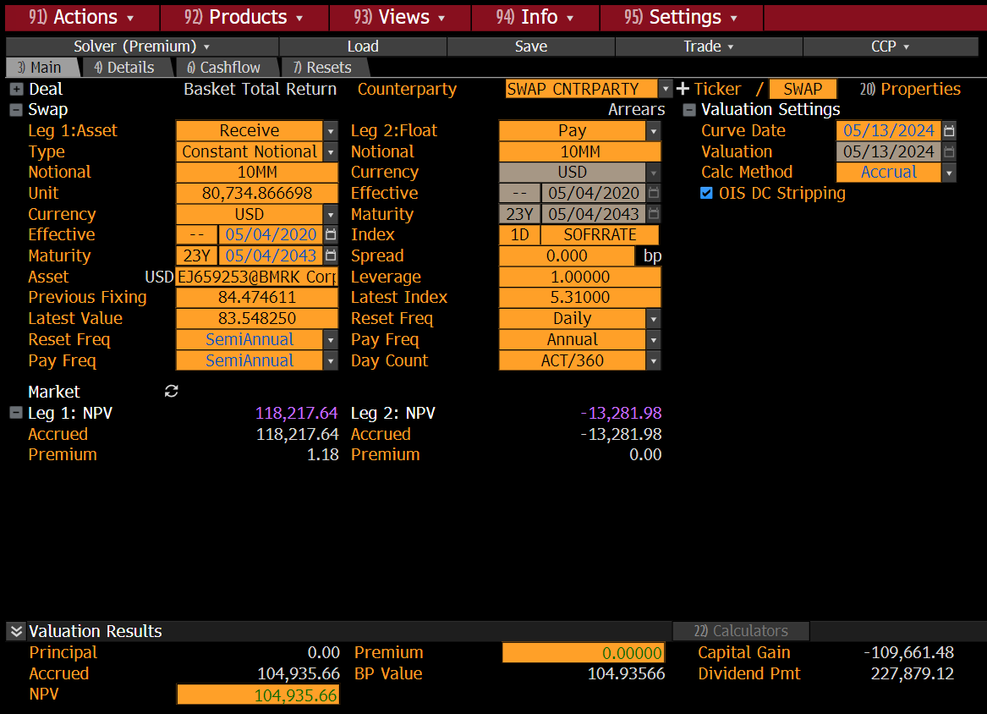
Bond TRS – Trade Features
OTC, Customizable and Highly Bespoke
Fixed Cash Amount or Fixed Number of Bonds
i.e. Constant Notional or Constant Units
Receive Bond Coupons & Performance
Pay Fixed or Float Funding
Interest Rate & Credit Risk (to Bond & Arranger)
Receiver Exposed to Loss Given Default (LGD)
Performance Projections Linked to Repo Rates
Pay Performance Regularly or At Maturity Only
Regular Performance Payments Reduce PFE¹ Exposure and XVA costs
¹ Potential Future Exposure
Notes:
Here on this slide we outline how to book a TRS and go over the contract specifications. For Bond TRS we must specify the economics of the trade and also the trade schedule

Slide 7
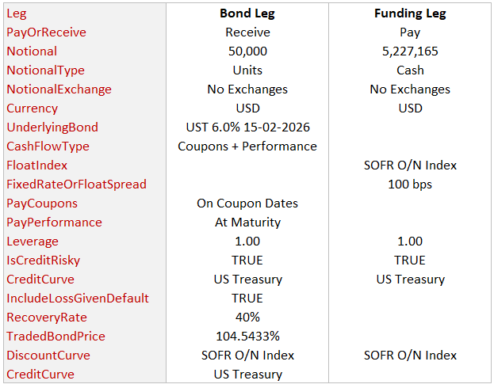
Bond TRS – Contract Specifications Example
Notional Specification
50,000 Bonds Purchased at 104.54.33%
Cash Equivalent USD 5,227,165 (= 50,000 x 100 x 104.5433% )
Bond Leg Specified as Number of Bonds (i.e. Units)
Coupon Payments
Bond Leg Receives Coupons & Performance
Funding Leg Pays SOFR + 100 bps
Performance Paid at Maturity Only
Credit Risky i.e. Cash Flows Scaled by Survival Probability
Pays Loss Given Default (LGD) = 1 – Recovery Rate
Notes:
Here on this slide we outline how to book a TRS and go over the contract specifications. For Bond TRS we must specify the economics of the trade and also the trade schedule

Slide 8
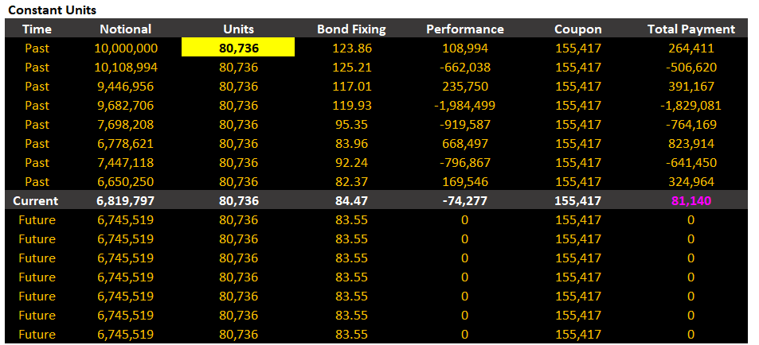


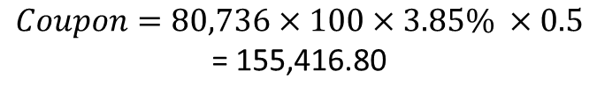
Bond TRS – Constant Units
Constant Units
Fixed Number of Bonds (Units)
Variable Cash Notional over Time
Every Period Cash Notional Exchanges
Bond Fixings Required
$$Units=\left(\frac{Cash Notional}{Face Value×Bond Fixing}\right)$$
$Coupon=Units×Face Value×Rate×Year Fraction$
$$Coupon=80,736×100×3.85\% ×0.5$$
= 155,416.80
$Units=\left(\frac{10,000,000}{100 × 123.86\%}\right)$ = 80,736

Slide 9
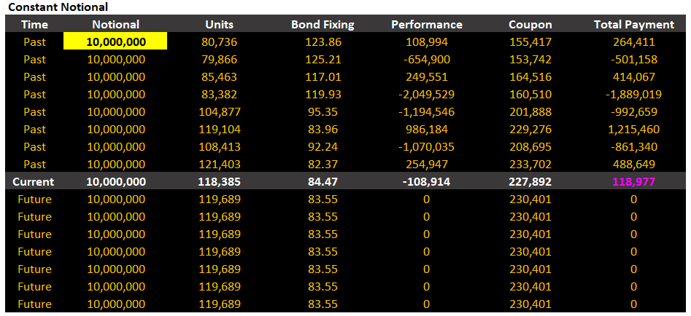
Bond TRS – Constant Notional
Constant Notional
Fixed Cash Notional
Variable Bond Units over Time
No Notional Exchanges Required
$$Units=\left(\frac{Cash Notional}{Face Value×Bond Fixing}\right)$$
$Coupon=Units×Face Value×Rate×Year Fraction$
$$Coupon=80,736×100×3.85\% ×0.5$$
= 155,416.80
$Units=\left(\frac{10,000,000}{100 × 123.86\%}\right)$ = 80,736

Slide 10
PART TWO – PRICING & PRACTICE
Pricing & Case Study

Slide 11
Bond TRS – Pricing Formula
Bond TRS has three main components,
Underlying Bond Coupons
Bond Performance
Funding Component
The Present Value of a TRS is the Sum of Discounted Cash Flows from these components.
However, in the event of bond default the TRS is unwound and the receiver of the bond coupons must pay the Loss Given Default (LGD) to the bond holder i.e. the payer. The LGD must be included in the PV calculation.

Slide 12
Bond TRS – Pricing
Bond TRS PV = ф ( PV(Bond Coupon) + PV(Performance) – PV(Funding Cash Flows) )
where ф = { +1 when receiving and -1 when paying bond coupons }

Slide 13
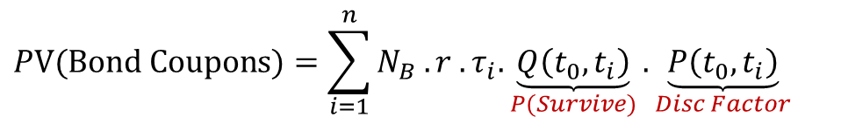
Bond TRS – Pricing the Bond Coupons
Coupon PV
For simplicity let’s define the quantity or Bond Notional (N_{B}) as Units x Face Value
This gives Coupon = Bond Notional x Rate x Year Fraction
Leading to PV(Coupon) = Bond Notional x Rate x Year Fraction x P(Survival) x Disc Factor
Let’s assume we have n Bond coupons
$$PV(Bond Coupons)=\sum_{i=1}^{n}{N_{B} . r . τ_{i}.\underset{P(Survive)}{\underbrace{Q\left(t_{0},t_{i}\right)}}.\underset{Disc Factor}{\underbrace{P\left(t_{0},t_{i}\right)}} }$$

Slide 14
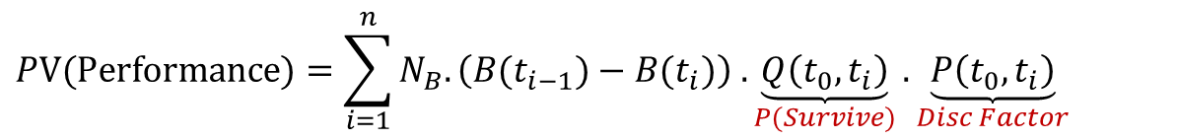
Bond TRS – Pricing the Bond Performance
Bond Performance PV
Bond Performance has the largest impact on the TRS PV
The performance captures the Change in Bond Price using Bond Fixings (or resets)
Change in Bond Price = Price at End of Coupon Period – Bond Price at Start of Coupon Period
Leading to PV(Performance) = Bond Notional x Change in Price x P(Survival) x Disc Factor
$$PV(Performance)=\sum_{i=1}^{n}{N_{B}. \left(B(t_{i−1})−B(t_{i})\right) .\underset{P(Survive)}{\underbrace{Q\left(t_{0},t_{i}\right)}}.\underset{Disc Factor}{\underbrace{P\left(t_{0},t_{i}\right)}} }$$
When Paying Performance on Coupon Dates
$$PV(Performance)=N_{B}.\left(B(t_{0})−B\left(T\right)\right).\underset{P(Survive)}{\underbrace{Q\left(t_{0},T\right)}}.\underset{Disc Factor}{\underbrace{P\left(t_{0},T\right)}}$$
When Paying Performance at Maturity, T

Slide 15


Bond TRS – Estimating or Projecting Future Bond Prices
Projecting Future Bond Prices
Future Bond Prices can be implied from Repo Rates
The repo rate acts like a Bond Growth Factor as if we can place a bond on deposit and earn bond interest
Repo rates work on Dirty Bond Prices
Calculation Using Repo Rates
The simple projected bond price is calculated as below,
We should however deduct repo interest from coupons (c) paid during the projection period,
where B_{t} is the Dirty Bond Price at time t, r the repo rate, c the coupon amount paid, t₁ denotes the time from t to T and t₂ the time from the coupon payment to time T
$$B_{T}=B_{t}(1+r τ)$$
$$B_{T}=B_{t}(1+r τ_{1}−r c{ τ}_{2})$$

Slide 16
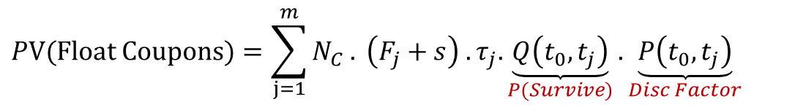
Bond TRS – Pricing the Funding Leg
Funding Leg PV
The client borrow funds to purchase the underlying bond
In exchange for receiving bond coupons and performance we pay funding costs
The funding leg has a Cash Notional (N_{C}), not to be confused with the bond notional (N_{B})
Let’s assume we are funding our position in USD using SOFR as the floating index plus a spread, denoted (F+s)
Then the Funding Cost or Float Coupon = Cash Notional x (SOFR + Spread) x Year Fraction
Leading to PV(Funding Leg) = Cash Notional x (SOFR + Spread) x Year Fraction x P(Survival) x Disc Factor
Let’s assume we have m floating coupons
$$PV(Float Coupons)=\sum_{j=1}^{m}{N_{C} . \left(F_{j}+s\right) .τ_{j}.\underset{P(Survive)}{\underbrace{Q\left(t_{0},t_{j}\right)}}.\underset{Disc Factor}{\underbrace{P\left(t_{0},t_{j}\right)}} }$$

Slide 17
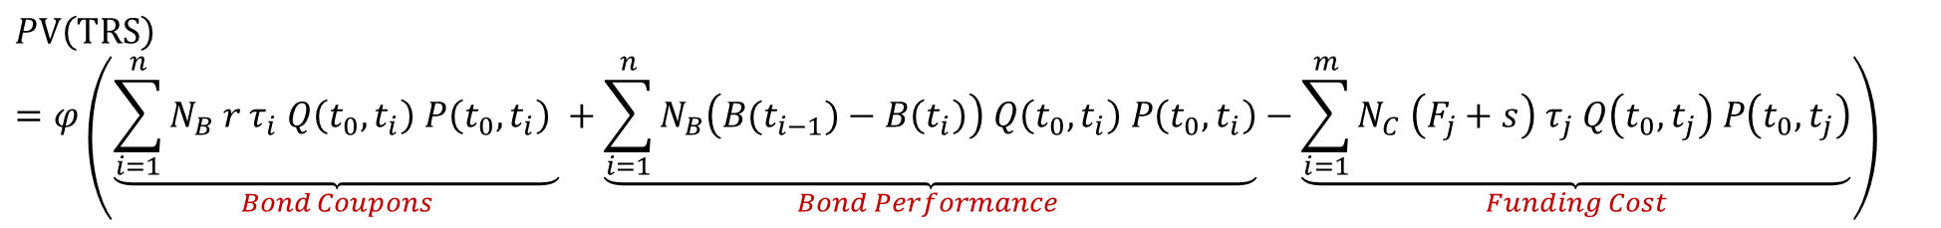
Bond TRS – TRS Pricing I
Putting Everything Together …
Bond TRS PV = ф ( PV(Bond Coupon) + PV(Performance) – PV(Funding Cash Flows) )
where ф = { +1 when receiving and -1 when paying bond coupons }
$$PV\left(TRS\right)=φ\left(\underset{Bond Coupons}{\underbrace{\sum_{i=1}^{n}{N_{B} r{ τ}_{i} Q\left(t_{0},t_{i}\right) P\left(t_{0},t_{i}\right) }}}+\underset{Bond Performance }{\underbrace{\sum_{i=1}^{n}{N_{B}\left(B(t_{i−1})−B\left(t_{i}\right)\right) Q\left(t_{0},t_{i}\right) P\left(t_{0},t_{i}\right)}}}−\underset{Funding Cost}{\underbrace{\sum_{i=1}^{m}{N_{C} \left(F_{j}+s\right) τ_{j} Q\left(t_{0},t_{j}\right) P\left(t_{0},t_{j}\right)}}}\right)$$

Slide 18
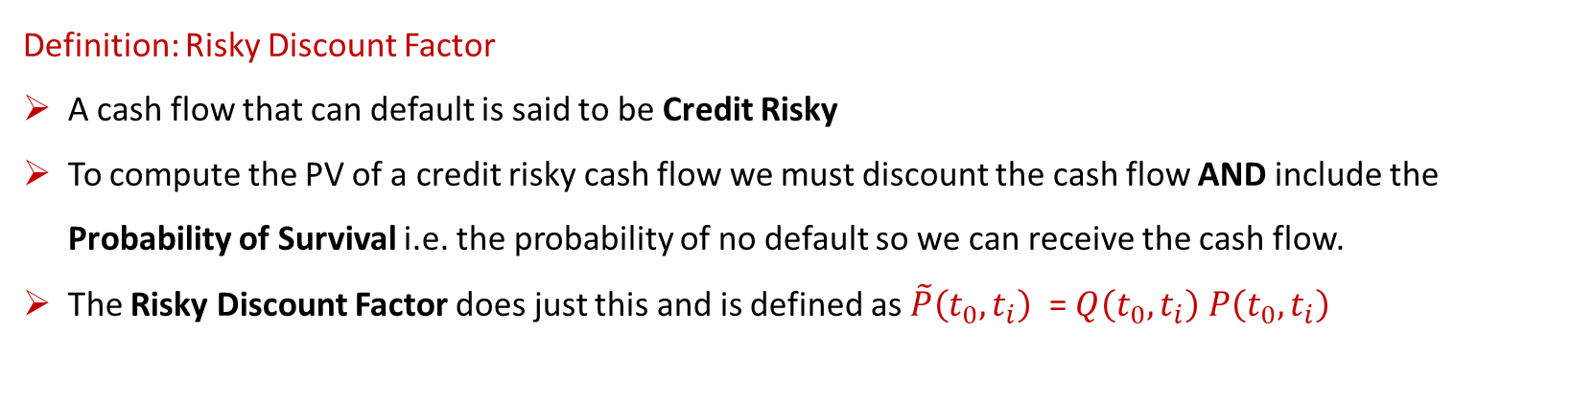
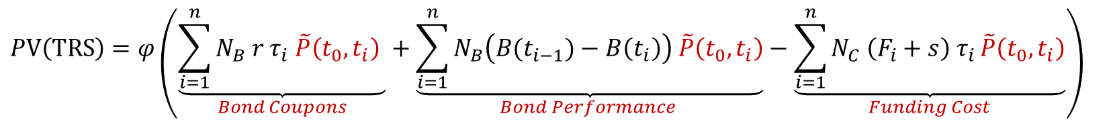
Bond TRS – TRS Pricing II
Definition: Risky Discount Factor
A cash flow that can default is said to be Credit Risky
To compute the PV of a credit risky cash flow we must discount the cash flow AND include the Probability of Survival i.e. the probability of no default so we can receive the cash flow.
The Risky Discount Factor does just this and is defined as $\tilde{P}\left(t_{0},t_{i}\right)$ = $Q\left(t_{0},t_{i}\right) P\left(t_{0},t_{i}\right)$
Using Risky Discount Factor Notation gives,
$$PV\left(TRS\right)=φ\left(\underset{Bond Coupons}{\underbrace{\sum_{i=1}^{n}{N_{B} r{ τ}_{i} \tilde{P}\left(t_{0},t_{i}\right) }}}+\underset{Bond Performance }{\underbrace{\sum_{i=1}^{n}{N_{B}\left(B(t_{i−1})−B\left(t_{i}\right)\right) \tilde{P}\left(t_{0},t_{i}\right)}}}−\underset{Funding Cost}{\underbrace{\sum_{i=1}^{n}{N_{C} \left(F_{i}+s\right) τ_{i }\tilde{P}\left(t_{0},t_{i}\right)}}}\right)$$

Slide 19
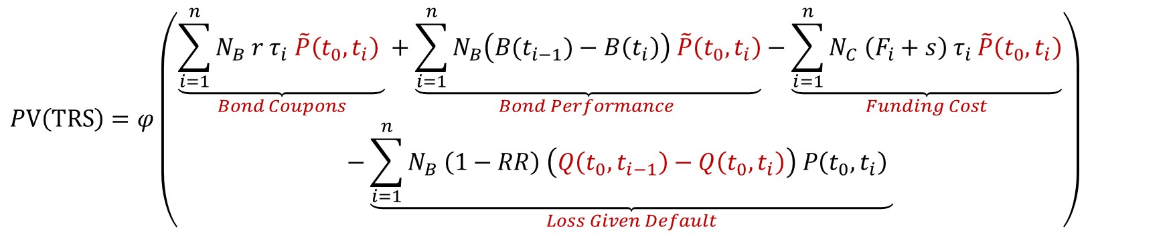
Bond TRS – TRS Pricing III
What about the Loss Given Default?
If the bond defaults the TRS is unwound and the Loss Given Default is paid by the bond coupon receiver
We must incorporate the LGD defined as N_{B}(1-RR), where RR is the recovery rate of the bond
In developed markets the recovery rate is usually assumed to be 40% for senior subordinated bonds
The probability of default during a coupon period is given by P(Default) = Q(t₀, t_{i-1}) - Q(t₀, t_{i}), which is the probability of surviving to the start of the coupon period minus that of surviving to the end of the coupon period.
$$PV\left(TRS\right)=φ\left(\begin{aligned}\underset{Bond Coupons}{\underbrace{\sum_{i=1}^{n}{N_{B} r{ τ}_{i} \tilde{P}\left(t_{0},t_{i}\right) }}}+\underset{Bond Performance }{\underbrace{\sum_{i=1}^{n}{N_{B}\left(B(t_{i−1})−B\left(t_{i}\right)\right) \tilde{P}\left(t_{0},t_{i}\right)}}}−\underset{Funding Cost}{\underbrace{\sum_{i=1}^{n}{N_{C} \left(F_{i}+s\right) τ_{i }\tilde{P}\left(t_{0},t_{i}\right)}}} \\ −\underset{Loss Given Default}{\underbrace{\sum_{i=1}^{n}{N_{B} \left(1−RR\right) \left(Q\left(t_{0},t_{i−1}\right)−Q\left(t_{0},t_{i}\right)\right) P\left(t_{0},t_{i}\right) }}}\end{aligned}\right)$$

Slide 20
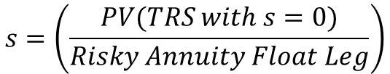
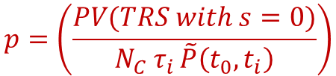
Bond TRS – The Breakeven Funding Spread (Par Spread)
What is the Breakeven Funding Spread or Par Spread?
This is the funding spread that gives a TRS price of zero or Par i.e. both trade legs have equal value
To calculate the par spread we rearrange the equation for PV(TRS) for the funding cost “s” parameter
We often rename the parameter “p” to indicate it is the par spread
The par spread is computed as,
The term in the denominator is called the Risky Annuity,
Giving,
$$p=\left(\frac{PV(TRS with s=0)}{N_{C} τ_{i }\tilde{P}\left(t_{0},t_{i}\right)}\right)$$
$${Risky Annuity\left(Float Leg\right)= N}_{C} τ_{i }\tilde{P}\left(t_{0},t_{i}\right)$$
$$s=\left(\frac{PV(TRS with s=0)}{Risky Annuity Float Leg}\right)$$

Slide 21
Appendix – Approximate Bond TRS Price I
Bond TRS Approximate Pricing Methodology
We can compute an approximate Bond TRS PV as follows,
Steps:
Bond Coupons – Compute the PV of Bond Coupons within the TRS start and end dates
Bond Performance – Compute the Performance using Bond Prices as follows,
Current Bond Price - Price the Bond
Forward Bond Price - Price the Bond again but with all coupons up to the TRS Maturity Date Removed
Funding Leg – Compute as Normal
Loss Given Default – Trivial to include, however for an approximate TRS PV we could perhaps ignore this for investment grade bonds i.e. assume Prob(Default) ≈ 0.

Slide 22
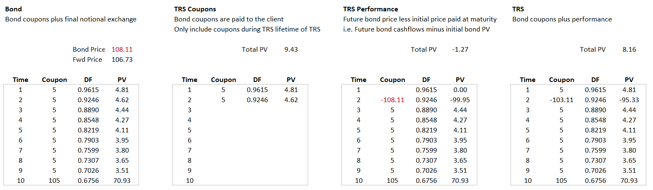
Appendix – Approximate Bond TRS Price II
What does the approximation look like when we net everything together?
Full Bond Cash Flows to Bond Maturity
Funding Leg has a Negative Notional Exchange Equal to the Current Bond Price Paid at TRS Maturity
Funding Leg to Maturity of TRS
Illustration – Bond Leg Coupons and Performance

Slide 23
Contact
Have questions or want further info?
LinkedIn: www.linkedin.com/in/nburgessx

